Slide 1
Do now
Connect the correct term with the correct answer:
Voltage Measures the voltage, in volts (V)
Current How fast the electrons move through the circuit
Voltmeter Measures the current, in amperes (A)
Ammeter The amount of energy that is ready to be turned into electricity

Slide 2
Resistance and ohm’s law

Slide 3
aims
Learning objectives:
We will learn about resistance in a circuit and what resistors are
We will learn about Ohm’s Law
Success criteria:
We will be able to describe how higher resistors affect the current in a circuit
We will be able to explain what happens to the energy in a circuit as it passes through a circuit
We will be able to use the equation V=IR to calculate voltage, current, and resistance
We will be able to predict what happens to the current of a system if we change the voltage

Slide 4
resistance
How much a component opposes the flow of current, measured in ohms (Ω)
If a component has a high resistance, it is hard for current to flow through it. If it has a low resistance, it is easier for current to flow through it. Think of it like rocks in a river
When a component moves through a resistor, it loses energy – this is the voltage drop
How big the voltage drop is depends on how strong the resistor is

Slide 5
resistors
Everything has a resistance, but we don’t call everything a resistor. For example, wires usually have a very low resistance
We can increase the resistance of a wire by:
Increasing its length; this is because the electrons have to travel further. If you double the length of a wire, you double is resistance
Decreasing its width; this is because less electrons fit in a narrow wire, so you lose more energy
Changing what its made out of; poorer conductors, like plastic, have higher resistances
Increasing its temperature; this is because the larger movement of the atoms in the wire can get in the way of the electron movement

Slide 6
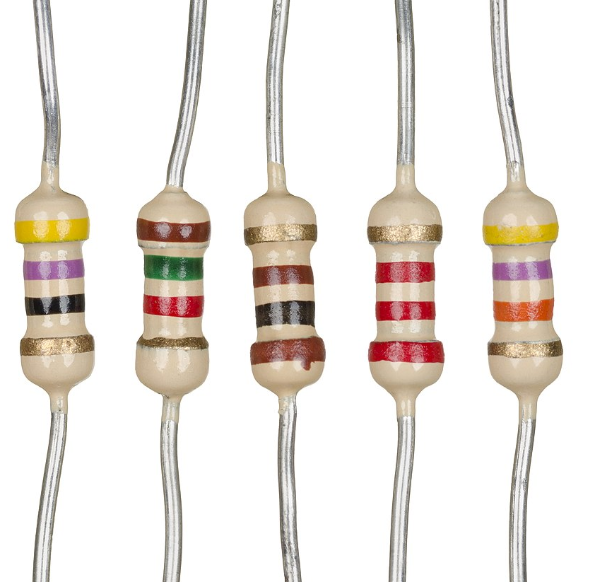
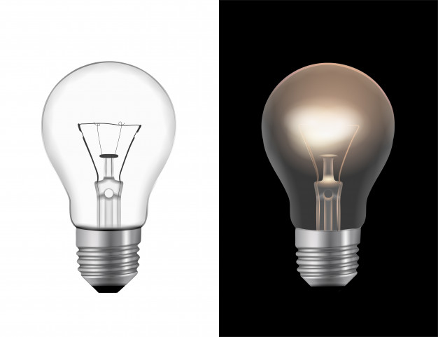
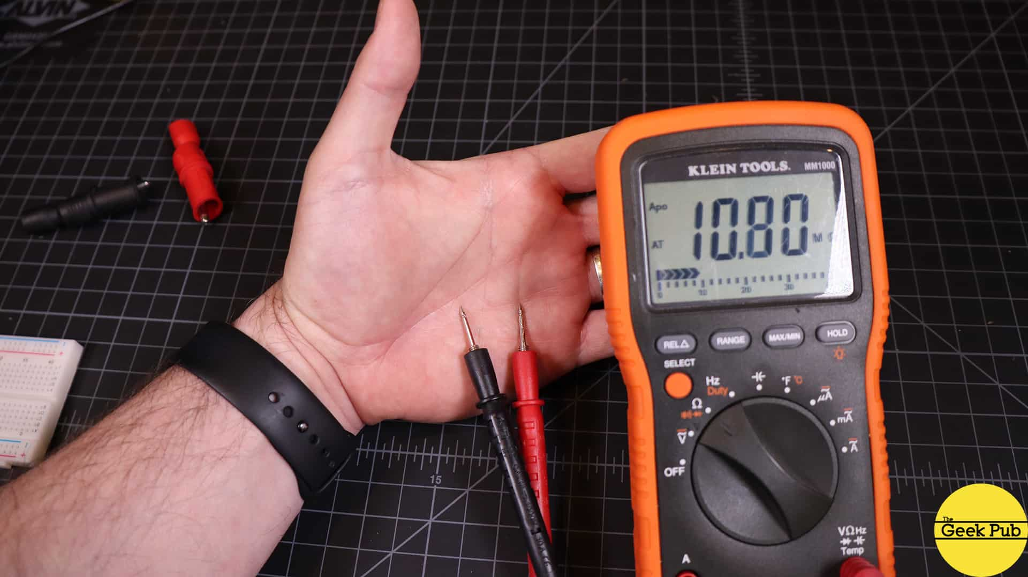
Types of resistors
Resistors
Light Bulbs
You?

Slide 7
Energy of resistors
When a current passes through a resistor, it loses energy (the ‘voltage drop’). Energy cannot be created from nothing or destroyed into nothing, so it must go somewhere
Most resistors turn the ‘lost’ energy into heat (e.g., your skin when you get shocked, some older heaters, older light bulbs)
Some resistors turn the ‘lost’ energy into light (e.g., lamps, plant zappers)
Some resistors even turn the ‘lost’ energy into sound (e.g., speakers)

Slide 8
Check for understanding 1
Which of the following is the correct units for resistance?
A, amperes
V, voltage
Ω, ohms
m, metres

Slide 9
Check for understanding 2
What happens to energy when it passes through a resistor?
It doubles
It disappears into nothing
It turns into something else (eg, light, sound, heat)
Nothing happens

Slide 10
Check for understanding 3
Which of the following will cause a decrease in a wire’s resistance:
Cutting it in half
Making it thinner
Taping it to another wire
Using plastic instead of metal

Slide 11
Check for understanding 4
If an object has a low resistance, then the current running through it will be…
Smaller
Zero
Faster
Infinite

Slide 12
Let’s do a science experiment!
https://phet.colorado.edu/sims/html/circuit-construction-kit-dc/latest/circuit-construction-kit-dc_en.html

Slide 13
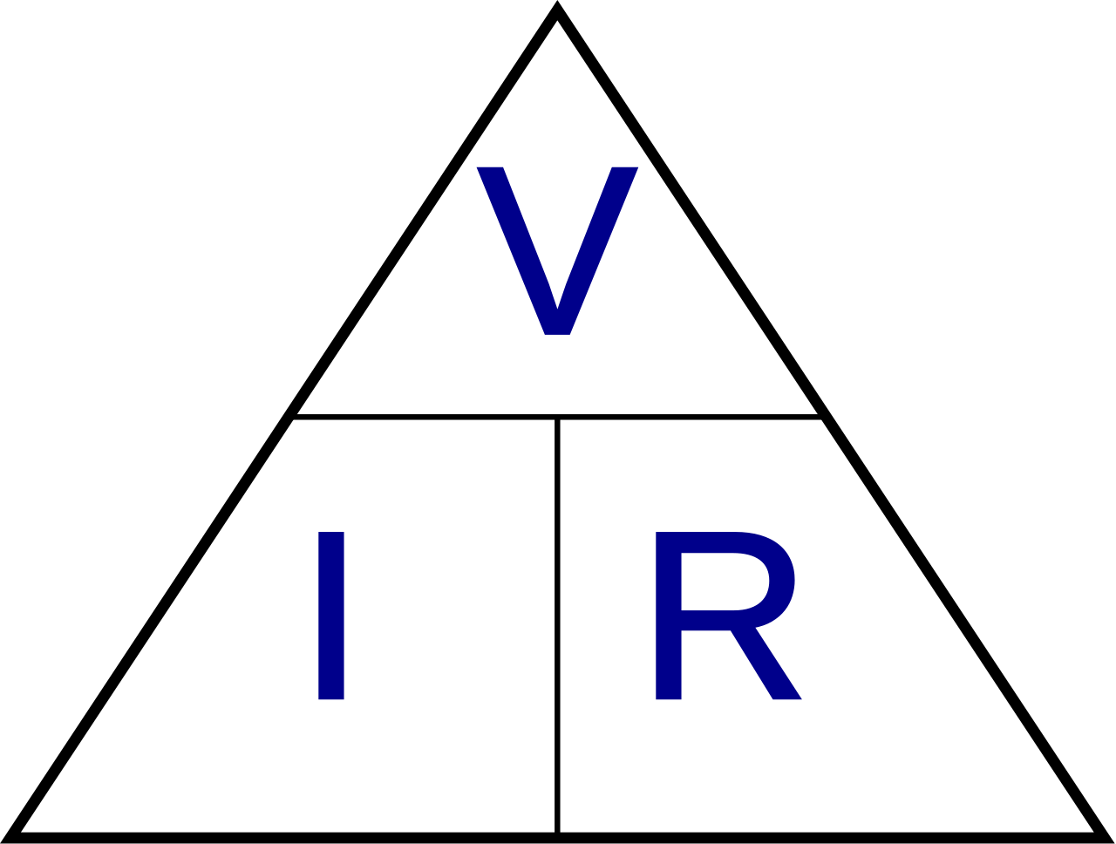
Ohm’s Law
V=IR, V=voltage, I=current, R=resistance

Slide 14
Using ohm’s law
A circuit is using a 6V battery to power a light. The total resistance of the circuit is rated at 3Ω. What is the current running through the circuit?

Slide 15
Indirectly using ohm’s law
A circuit currently has a 5Ω resistor inside of it. Assuming the battery is not replaced, what will happen to the current if a second resistor is placed inside the circuit?
A circuit housing a 9V battery has its battery replaced with a 6V battery. What will happen to the current of that circuit?
An increase in voltage = an increase in current; an increase in resistance = a decrease in current

Slide 16
Check for understanding 5
Which of the following equations will tell you the total resistance of a circuit?
R=IV
R=V/I
R=I/V
R=1/(IV)

Slide 17
Check for understanding 6
If I increase the voltage of a circuit, what will happen to the current?
It will decrease
It will go to 0
It will stay the same
It will increase

Slide 18
Independent working
Explain why increasing the length of a wire will cause its resistance to increase
A circuit has a voltage of 7V and an ammeter is used to measure its current, and it detects a current of 0.7A. What is the resistance of the circuit?
A circuit has a voltage of 10V and a resistance of 5Ω. If the 10V battery is replaced with a 15V battery, what will the resistance need to be changed to so that the current stays the same?
Explain why plastics have a higher resistance than metals

Slide 19
aims
Learning objectives:
We will learn about resistance in a circuit and what resistors are
We will learn about Ohm’s Law
Success criteria:
We will be able to describe how higher resistors affect the current in a circuit
We will be able to explain what happens to the energy in a circuit as it passes through a circuit
We will be able to use the equation V=IR to calculate voltage, current, and resistance
We will be able to predict what happens to the current of a system if we change the voltage

